Slide 1
Numba
Fast loops without without Compilation

Slide 2

Fast Loops!
Why? Scientific Computing / Number crunching

Slide 3

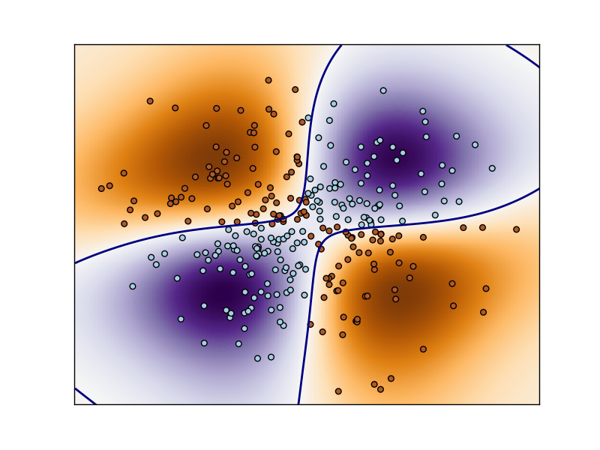
scikit-learn

Slide 4

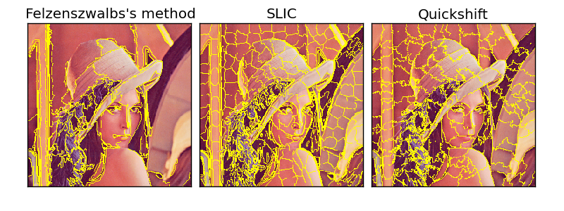
scikit-image

Slide 5
Cython : Fast loops with compiling
Write Python code
Compile to C with Cython
Optional strong typing for speed

Slide 6


Slide 7

BUT
pretty static :-/

Slide 8
Enter Numba
Travis Oliphant's new project http://numba.pydata.org LLVM JIT via decorators!
Tight Numpy integration

Slide 9
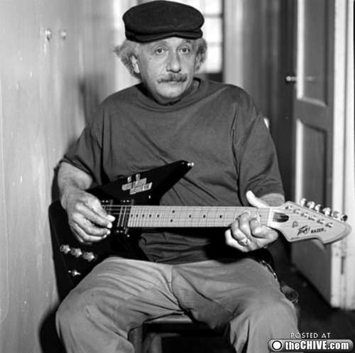

Slide 10
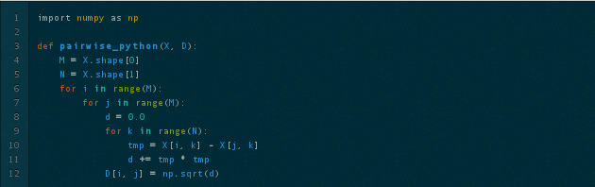
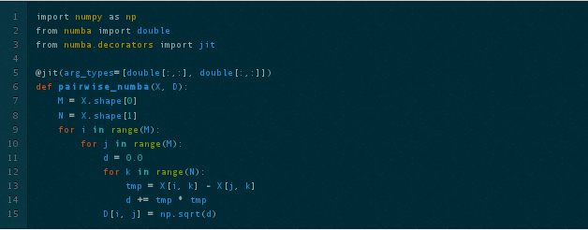

Slide 11
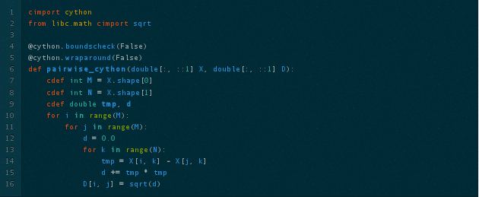

Example stolen from Jake:
http://jakevdp.github.com

Slide 12
Resources
Website
http://numba.pydata.org
Github
https://github.com/numba/numba Early stage, worth taking a look!
\

